Slide 1
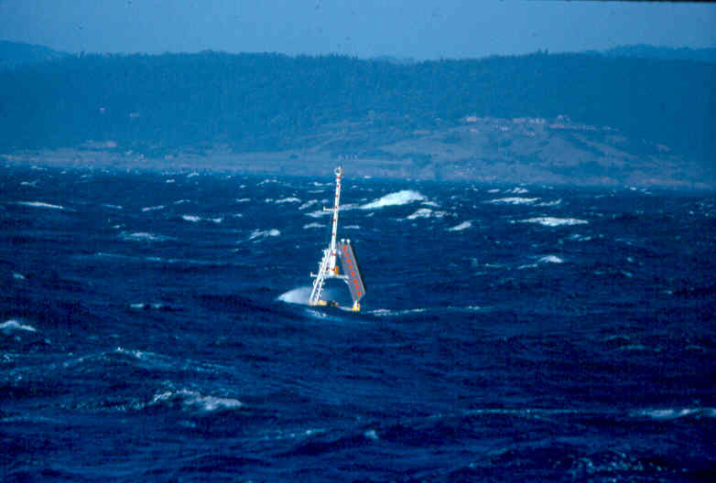

Wind-driven shelf circulation 2019 Estuarine and Coastal Fluid Dynamics Summer School at Friday Harbor
Steve Lentz (Woods Hole Oceanographic Institution)

Slide 2
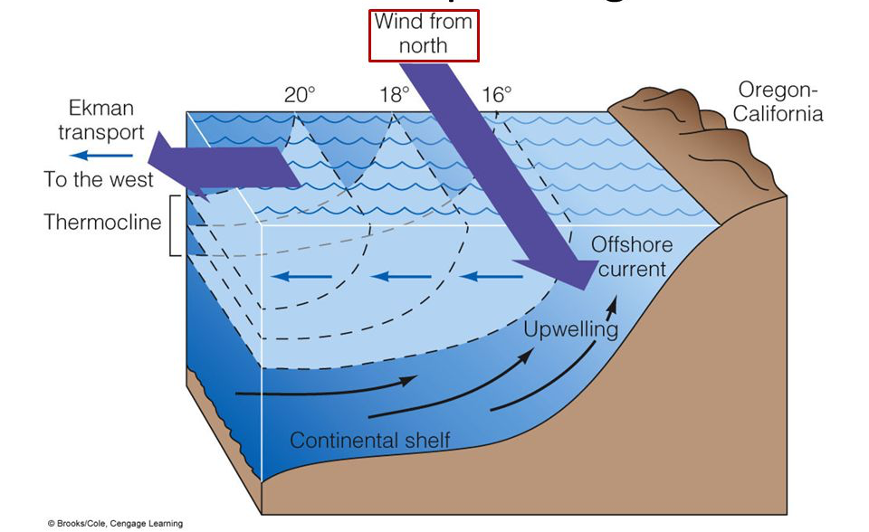
General Question: What processes drive exchange across continental shelf? Classic example for wind forcing is coastal upwelling
Chlorophyll
SST

Slide 3
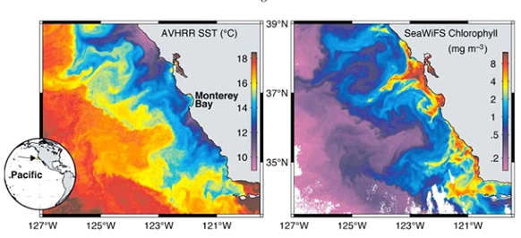
Motivation: Coastal upwelling drives biological productivity by bringing up cold nutrient rich water to the surface

Slide 4
What are dynamics that lead to wind-driven coastal upwelling?
Chlorophyll
SST

Slide 5
equations of motion – rotating earth
Coriolis

Slide 6
Start by considering a steady,1-D ocean with no lateral variations
z
y
x
h

Slide 7
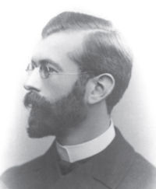
Ekman 1905 – rotation, steady,1-D ocean with no lateral variations (classic paper in oceanography)

Slide 10
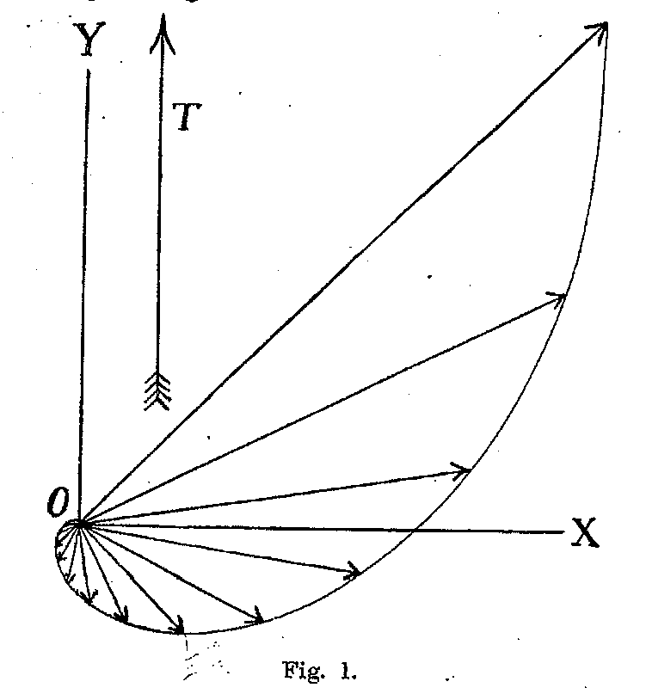
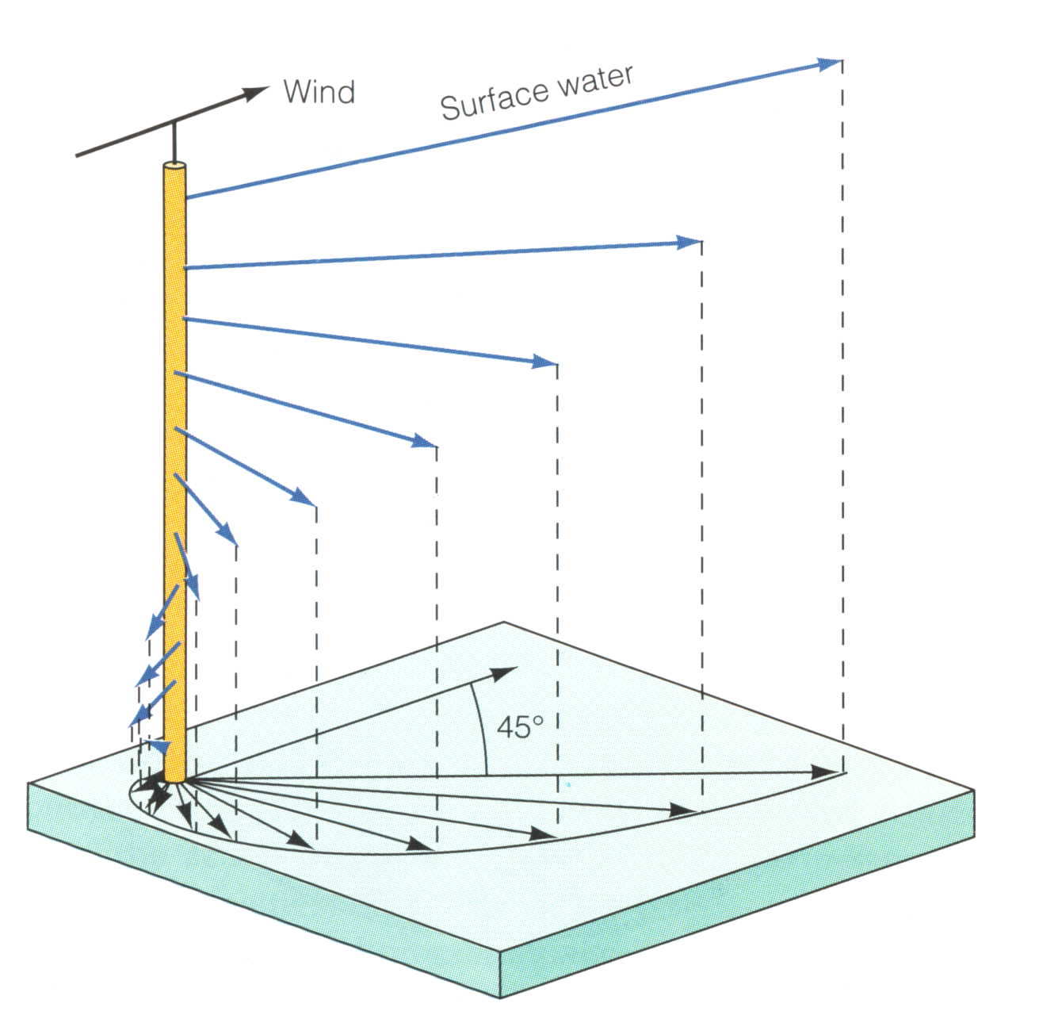
So what does the flow look like in deep water? Ekman spiral
Ekman 1905

Slide 12
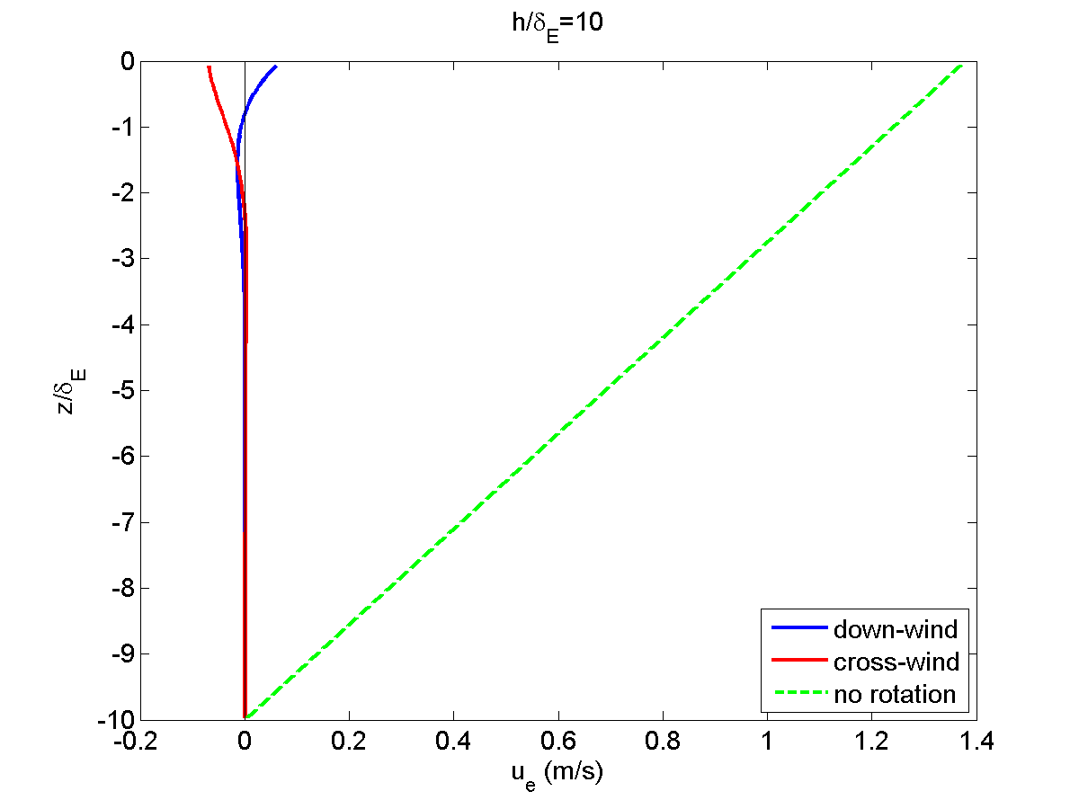
Earth’s rotation has profound effect on boundary layer response
deep water limit
rotating
downwind
cross-wind
What are key features?
non-rotating (f=0)
downwind flow
Notes:
Rotation – 1/f hours; h^2/Av weeks for h~100 m, Av = 0.01 m2/s

Slide 13
Earth’s rotation has profound effect on boundary layer response
Rotation limits thickness of boundary layer
Net transport cross-wind
no net downwind transport
Time-scale to reach steady state 1/f (hours at mid-latitude) as opposed to diffusive time scale
h²/A_{v} (years in deep water)
Notes:
Rotation – 1/f hours; h^2/Av weeks for h~100 m, Av = 0.01 m2/s

Slide 14
Constant eddy viscosity is not realistic. What should the eddy-viscosity profile look like? How will this change the response?

Slide 15
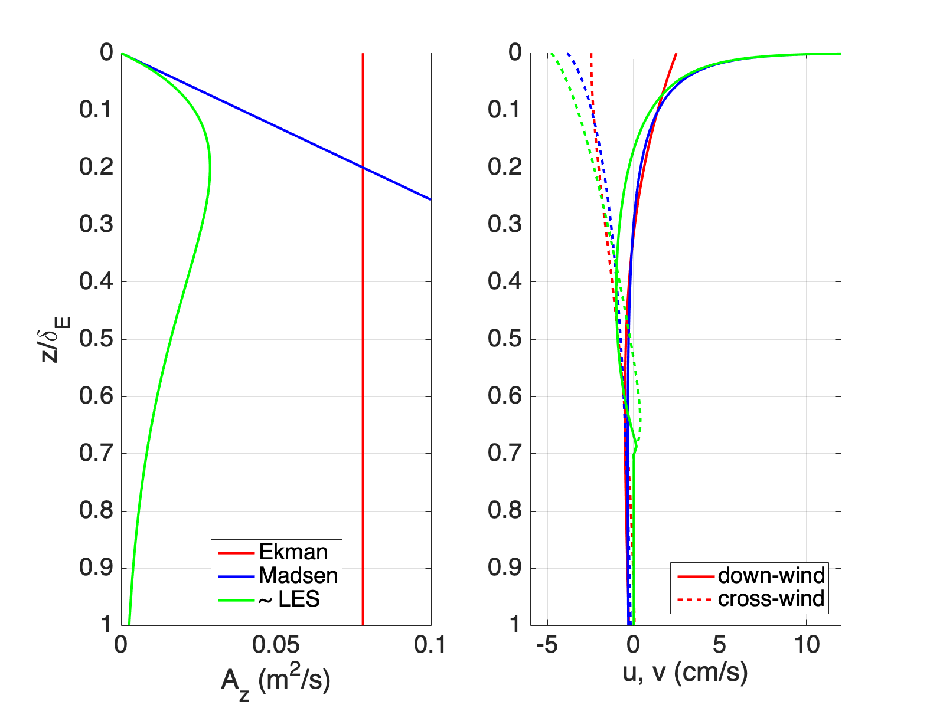
Deep water Ekman more realistic eddy viscosity profiles

Slide 16
What happens in shallow water?

Slide 17
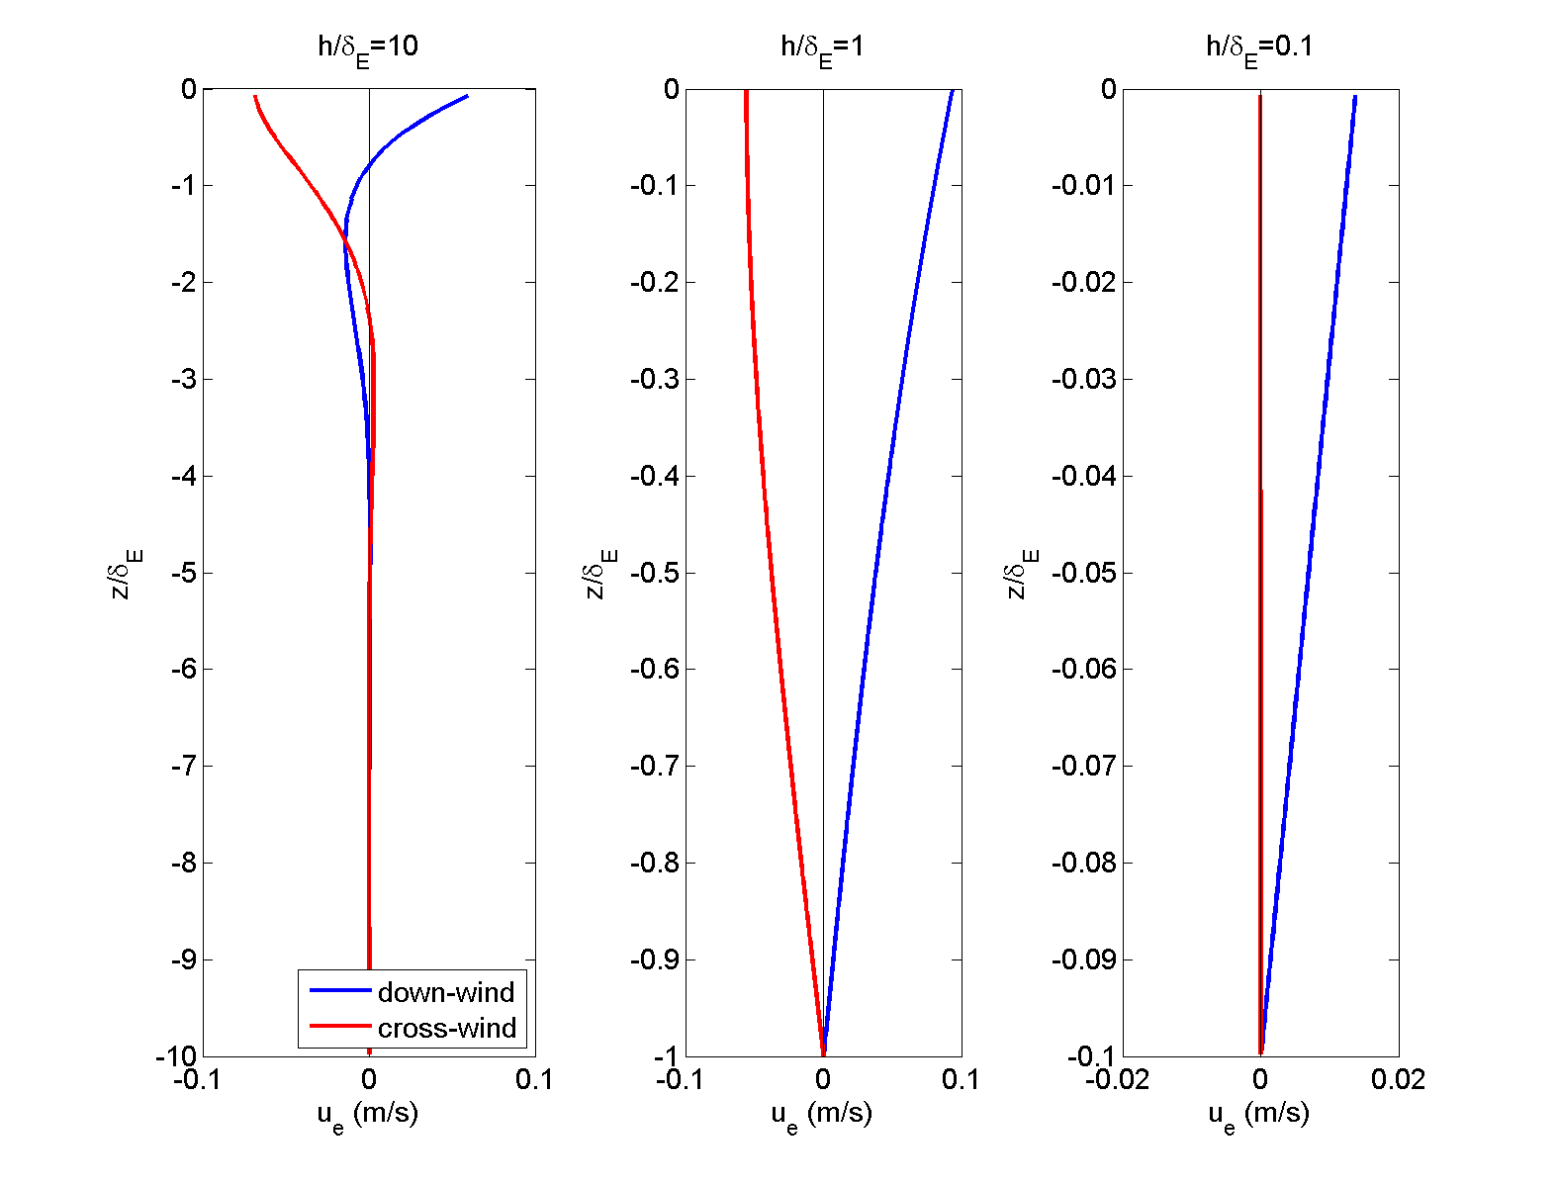
Notes:
Rotation – 1/f hours; h^2/Av weeks for h~100 m, Av = 0.01 m2/s

Slide 18
Physical interpretation? (What are processes?)
Notes:
Rotation – 1/f hours; h^2/Av weeks for h~100 m, Av = 0.01 m2/s

Slide 19
Physical interpretation
Notes:
Rotation – 1/f hours; h^2/Av weeks for h~100 m, Av = 0.01 m2/s

Slide 20
Now consider steady, two-dimensional continental shelf
z
y
What’s different?
What do you expect to happen?
x

Slide 21
Steady, unstratified, linear, 2D (no alongshore variations) equations of motion (Ekman 1905 also did this problem)

Slide 22
Continuity – coastal boundary condition

Slide 23
Momentum balances

Slide 24
Momentum balances – let’s look at vertically integrated balances first

Slide 26
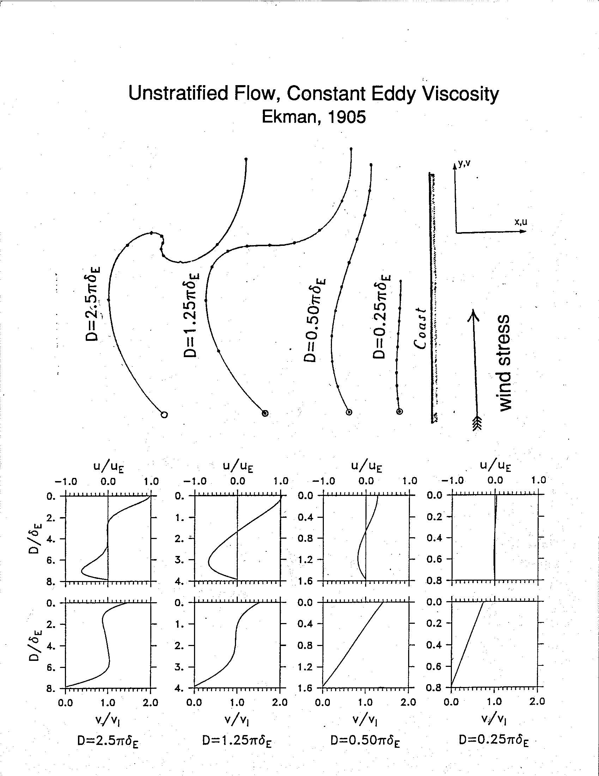
Similar to 1D - deep water cross-shelf transport in surface and bottom Ekman layers -shallow water no cross-shelf transport so coastal boundary condition satisfied

Slide 27
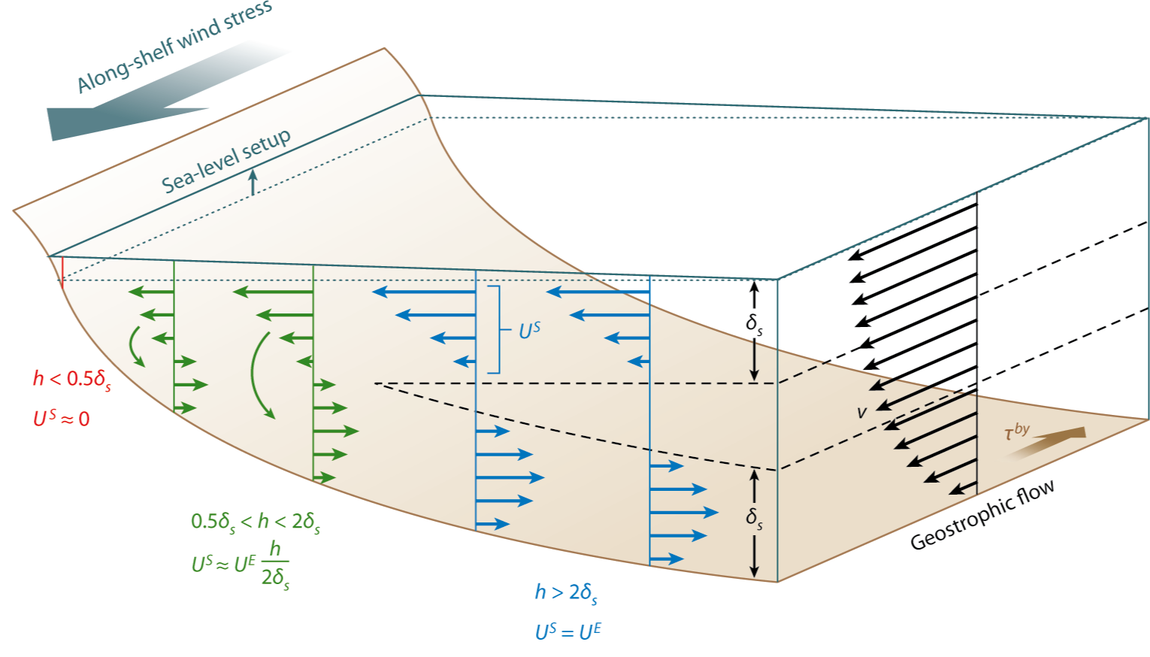
Summary unstratified flow

Slide 28
Steady-state – how did we get there?
Offshore Ekman transport, set down drives onshore interior flow, no alongshelf flow and no bottom stress
Coriolis onshore interior flow accelerates alongshelf flow generates bottom stress onshore bbl flow
Alongshelf flow accelerates until surface stress equals bottom stress and no onshore interior flow because surface and bottom Ekman transports equal

Slide 29
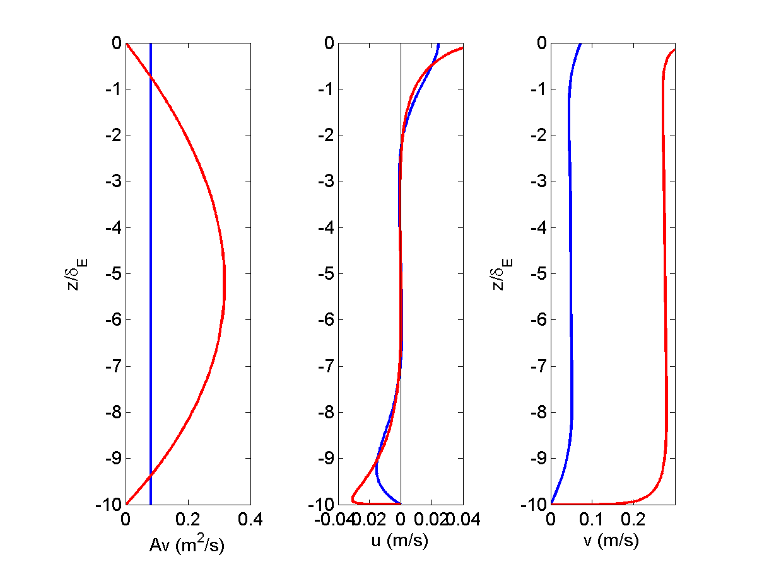
Again response is qualitatively similar for more realistic eddy-viscosity – though notice alongshelf flow.

Slide 30
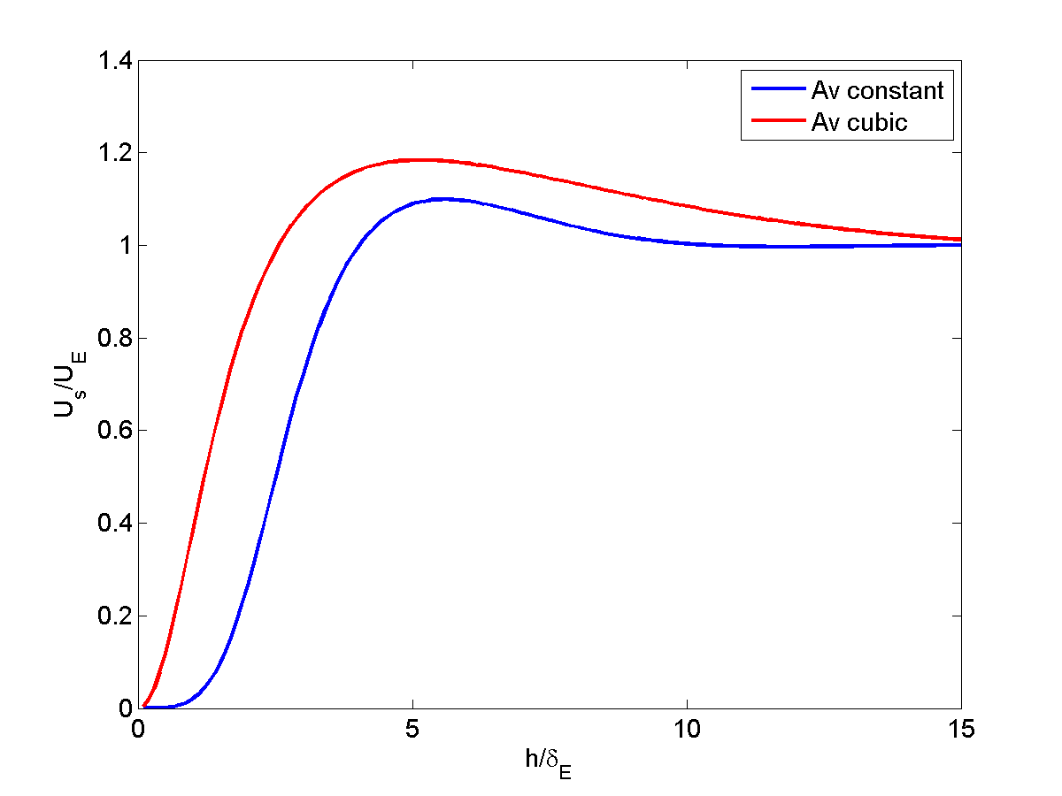
Cross-shelf transport vs water depth
Region of upwelling
or downwelling
deep water – U_{s} ~ U_{E}
U_{s}
shallow water – U_{s} ~ 0

Slide 31
What happens when shelf water is stratified (density increases with depth)?
Stratification inhibits vertical mixing
Complicated feedbacks between stratification,
vertical mixing, and
currents (requires numerical model)

Slide 32
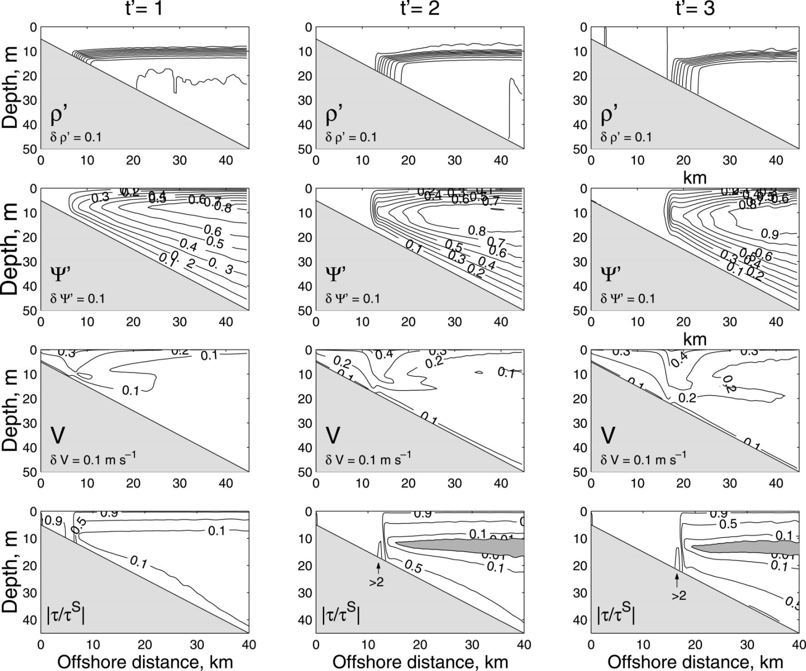
downwelling response (Austin and Lentz JPO 2002)
light
dense
density
cross-shelf
circulation
alongshelf
current
stress

Slide 33
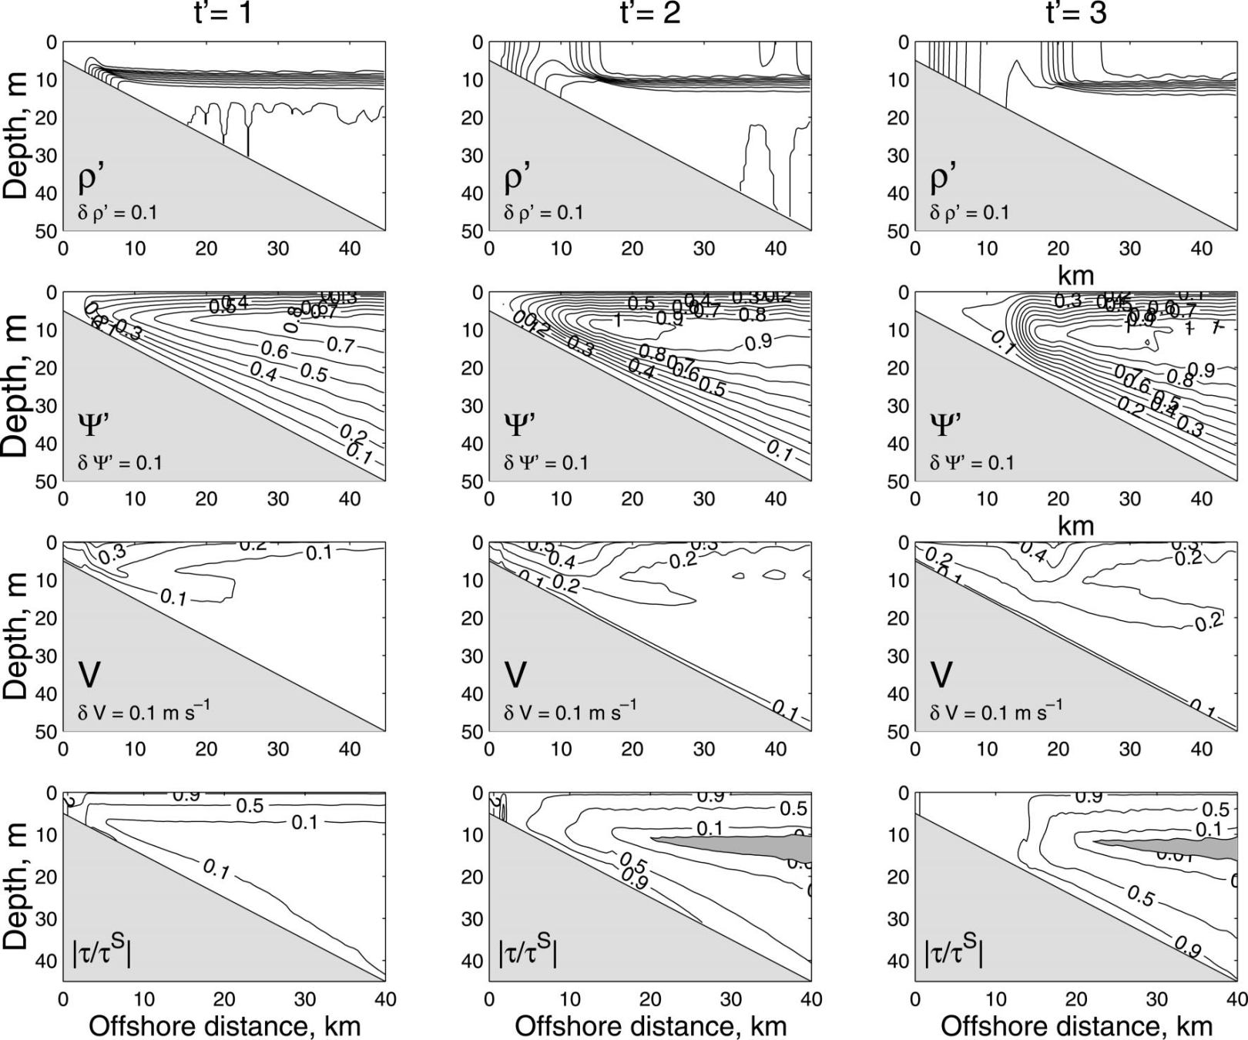
Upwelling response (Austin and Lentz JPO 2002)
density
cross-shelf
circulation
alongshelf
current
stress

Slide 34
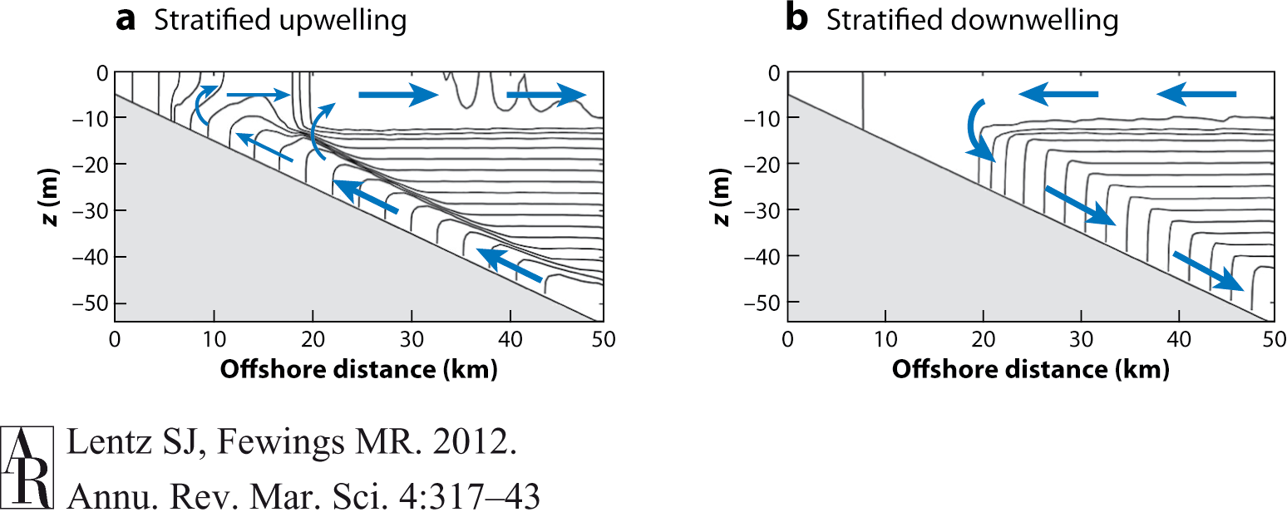
Two-dimensional stratified response
Upwelling and downwelling not symmetric
Upwelling inner-shelf stratified, weak cross-shelf circulation
Downwelling inner-shelf unstratified, no cross-shelf circulation

Slide 35
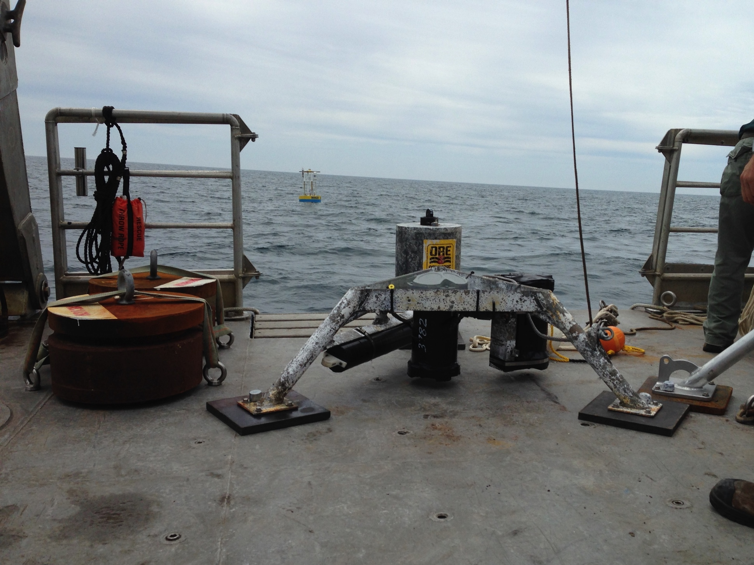
Observations to test theory

Slide 36
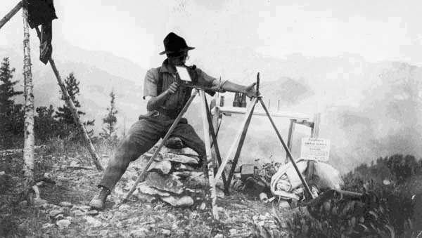
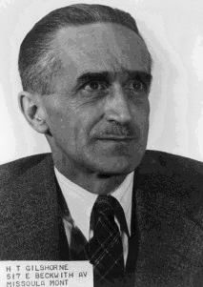
“To Gisborne, science started and ended in observation, and theory should always be endangered by it.”
Young Men and Fire
Norman Mclean

Slide 37
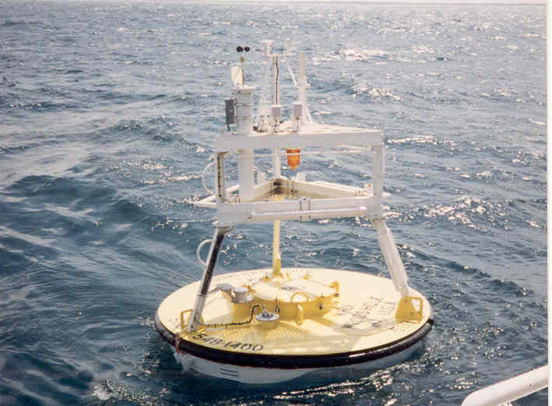
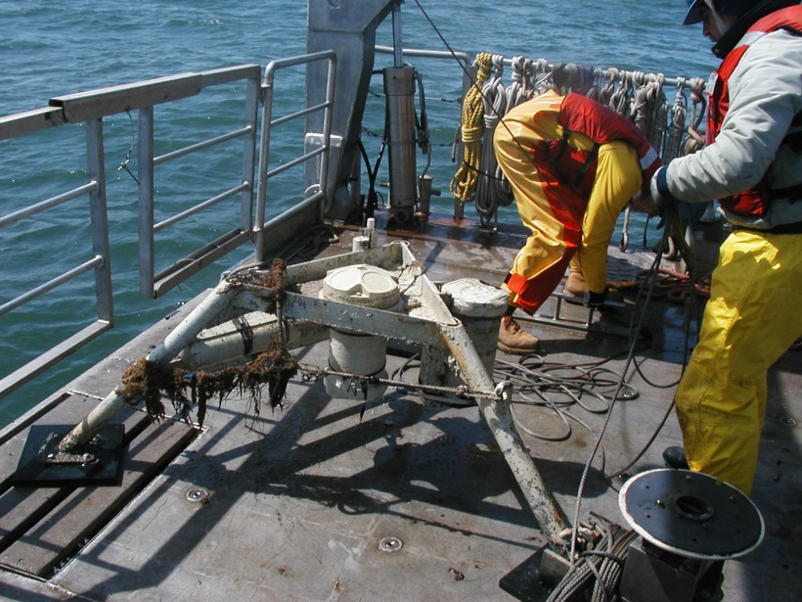
Measurements to test theory
meteorological buoy
temperature
conductivity
acoustic beams
mooring
bottom
frame
ADCP
anchor

Slide 38
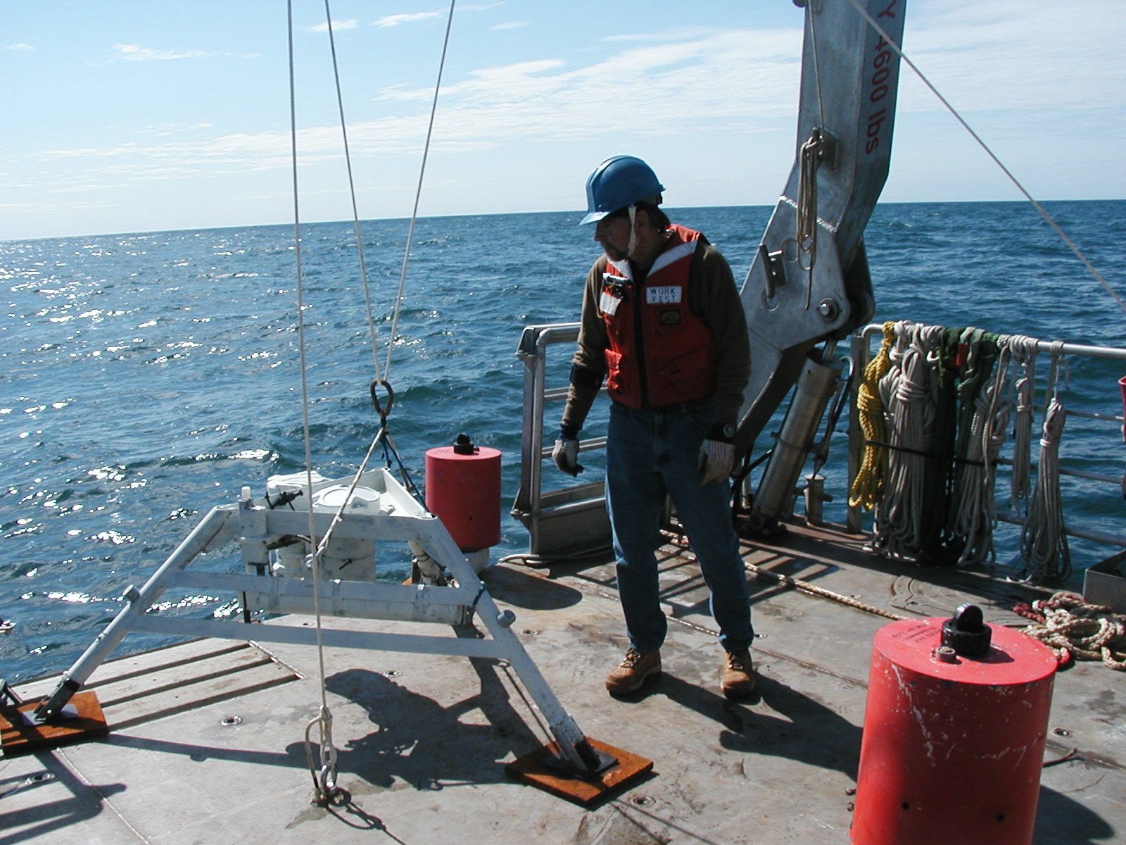
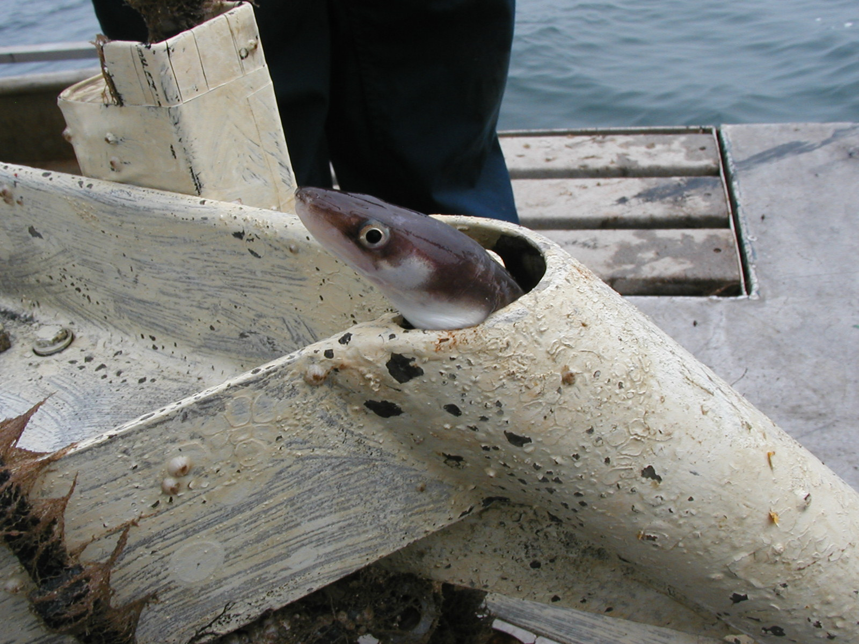
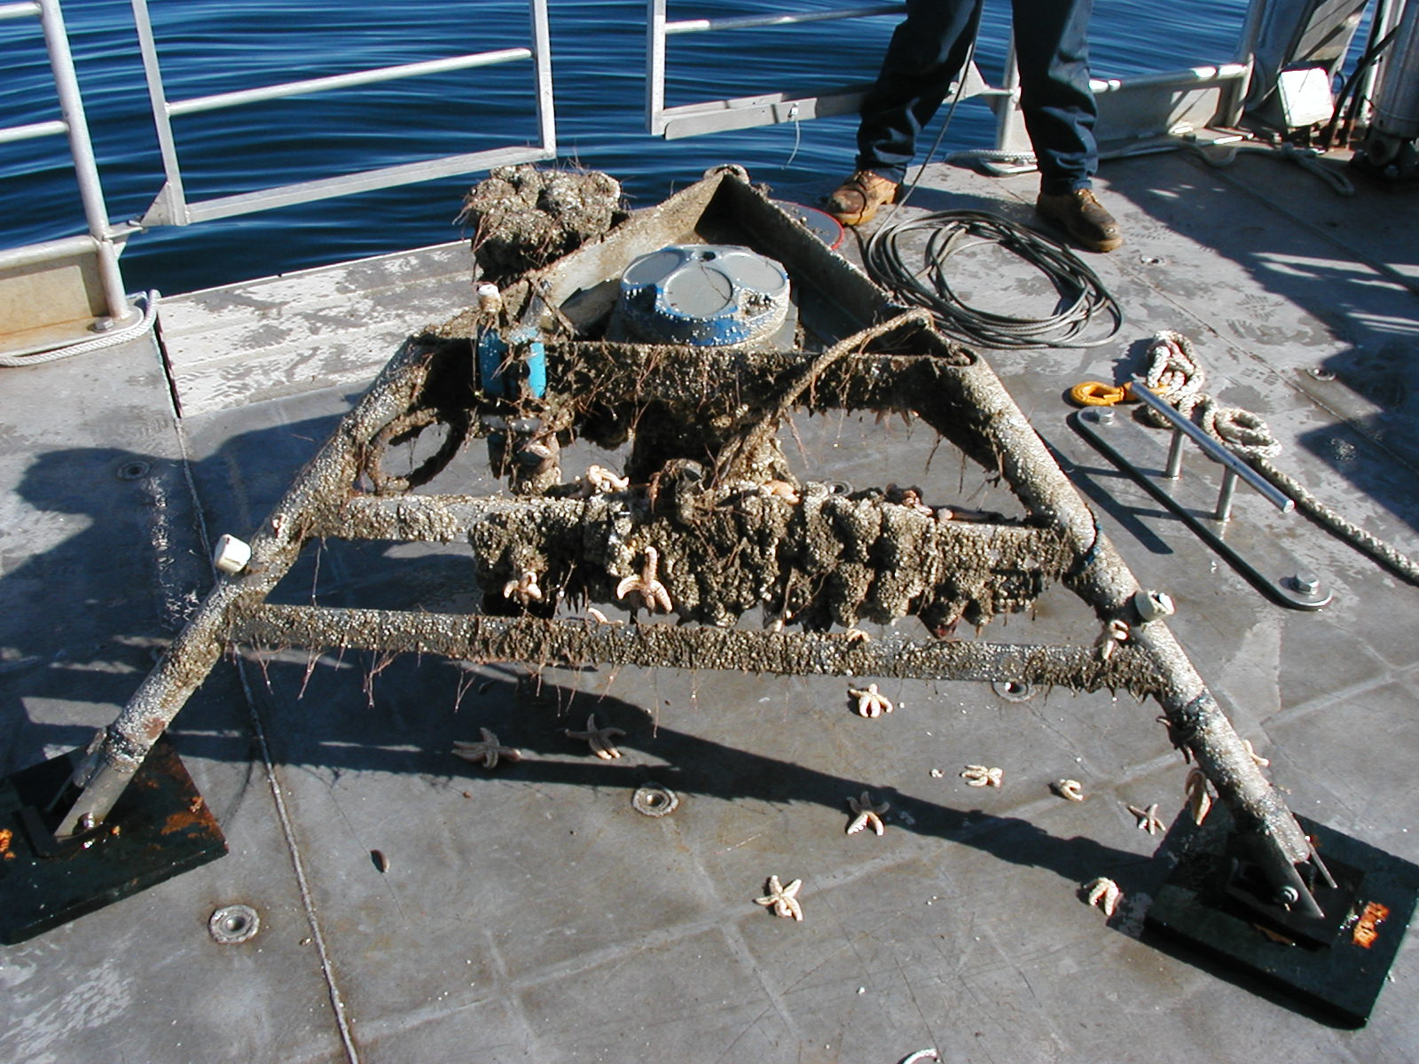
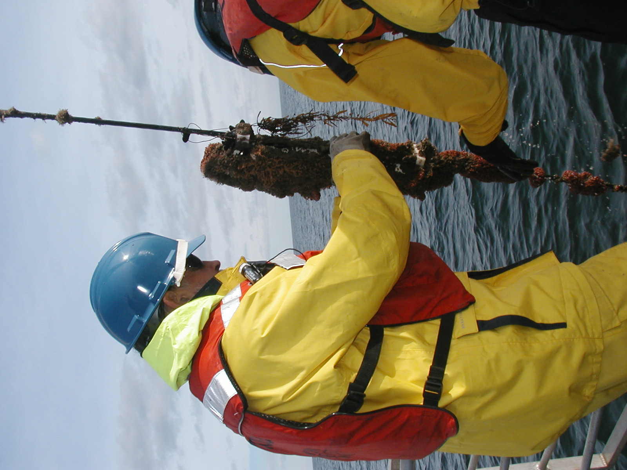
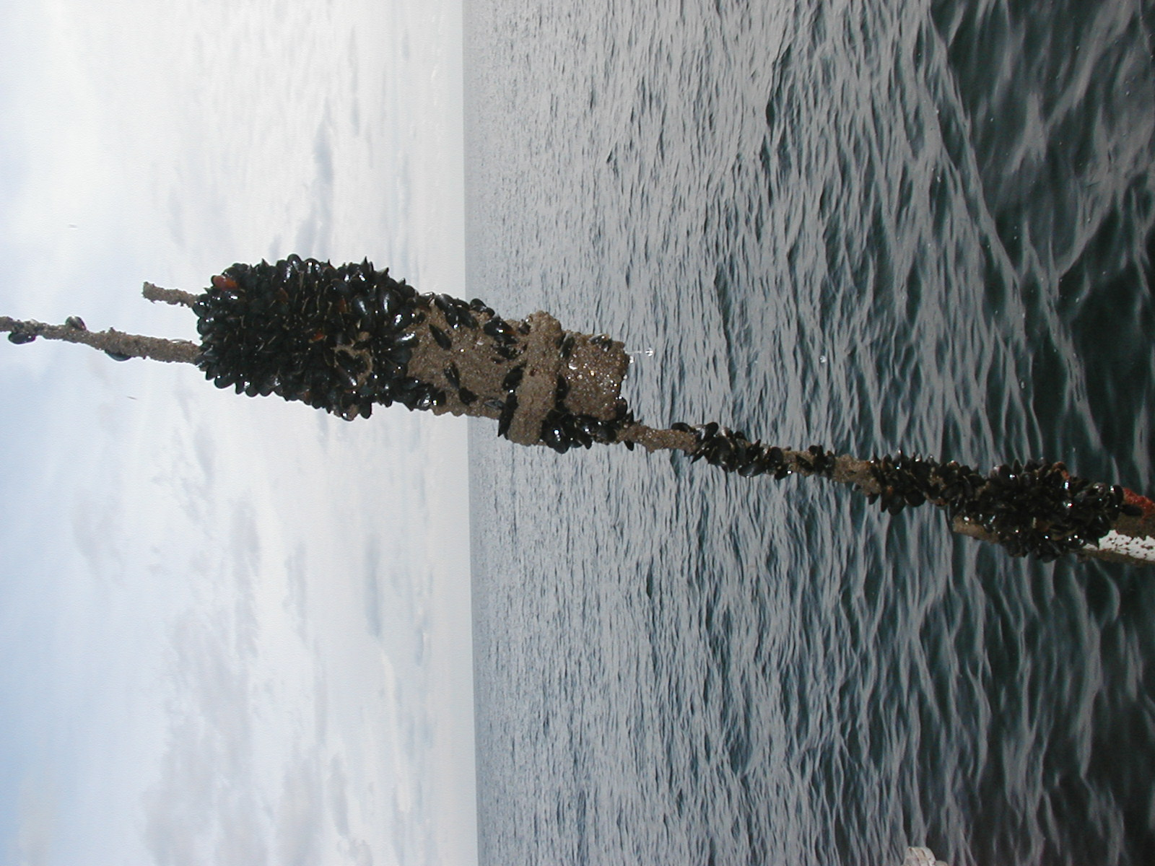
before
Measurements aren’t perfect!
after

Slide 39
Estimating cross-shelf transport U_{obs} and Ekman transport U_{E}
0
U_{obs}
5
10
depth (m)
15
20
25
-4
-3
-2
-1
0
1
onshore current (cm/s)

Slide 40
Comparison of observed and predicted cross-shelf transport
2
t
/s)
0
2
U (m
-2
τ
sy
ρ
-4
9
14
19
24
29
3
8
13
18
23
28
3
8
13
18
23
28
2
7
Aug
Sep
Oct
Nov
North Carolina water depth 26 m
6
U
4
σ
θ
Δ
2
0
-2
9
14
19
24
29
3
8
13
18
23
28
3
8
13
18
23
28
2
7
Aug
Sep
Oct
Nov
1994

Slide 41
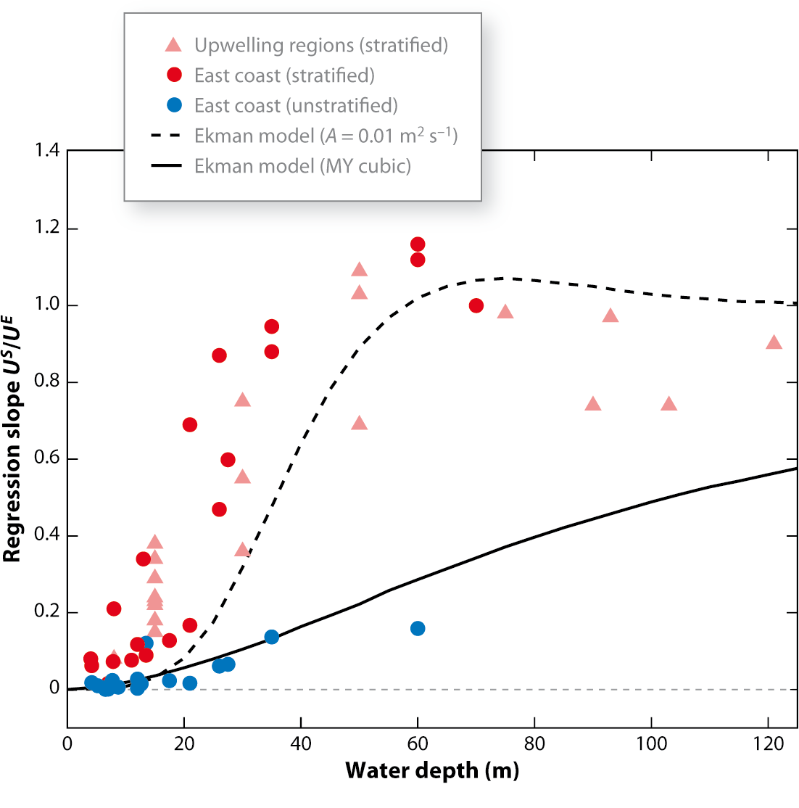
Along-shelf wind-driven cross-shelf transport linear regression U_{obs} = a U_{E} +b

Slide 42
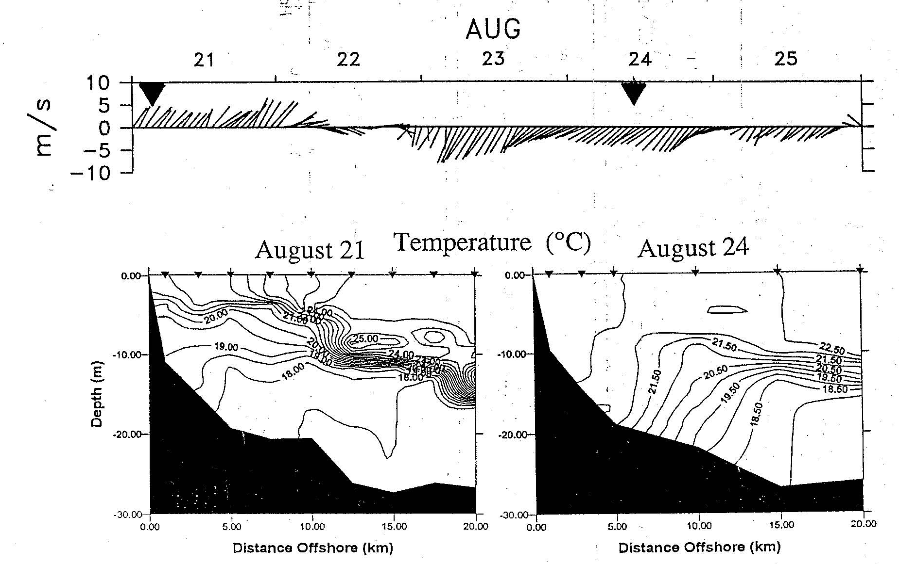
Stratified asymmetry? Qualitative evidence but quantitative observational evidence lacking

Slide 43
Summary
Upwelling/downwelling (unstratified) occurs where
Ekman model of upwelling/downwelling qualitatively consistent with observations
Stratified response not well understood
3D???

Slide 44
Cross-shelf wind forcing
In contrast to along-shelf wind forcing,
Ekman transport is along-shelf
no net cross-shelf Ekman transport
don’t set up a geostrophic alongshelf flow

Slide 45
What about shallow water where Coriolis terms are small? Wind-driven setup

Slide 46
What about shallow water where Coriolis terms are small? wind-driven setup

Slide 47
Cross-shelf circulation driven by cross-shelf (red) and along-shelf (blue) winds Ekman 1905
deep water
shallow water
0
0
20
2
4
40
depth (m)
depth (m)
6
60
8
10
80
-5
0
5
u (cm/s)
cross-shelf winds drive stronger
cross-shelf flow in shallow water
100
-10
-5
0
5
10
u (cm/s)

Slide 48
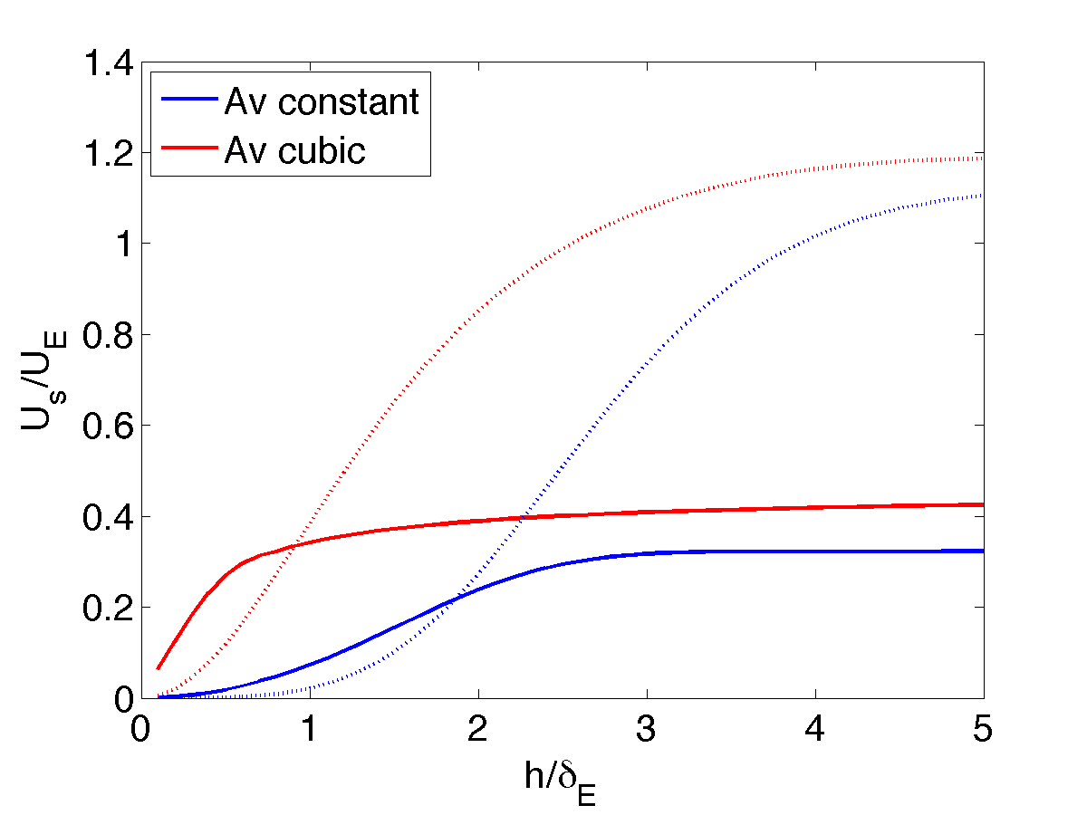
cross-shelf transport
cross-shelf winds drive larger
cross-shelf transport in shallow water
along-shelf
wind stress
0
2
4
depth (m)
6
8
cross-shelf
wind stress
10
-5
0
5
u (cm/s)

Slide 49
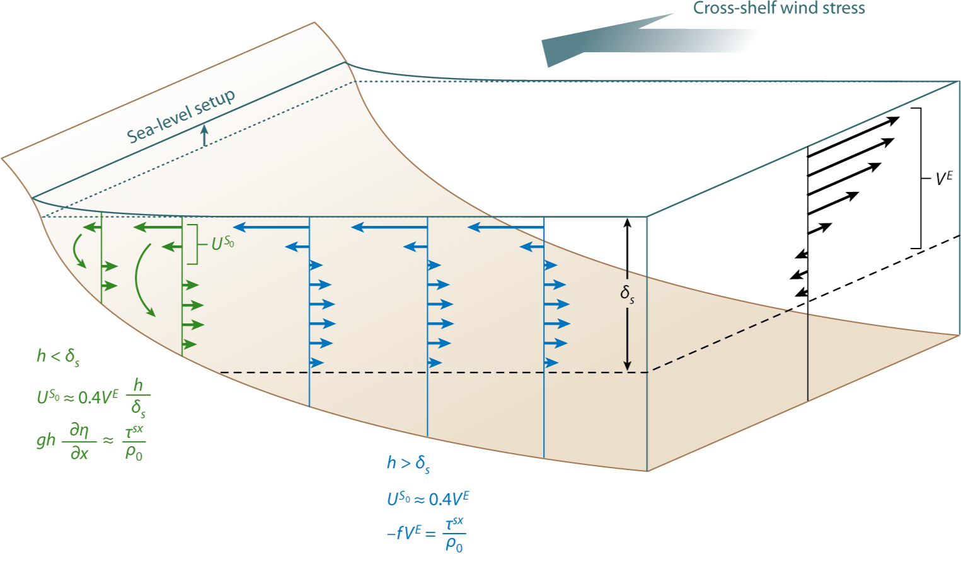
Summary – cross-shelf wind forcing

Slide 50
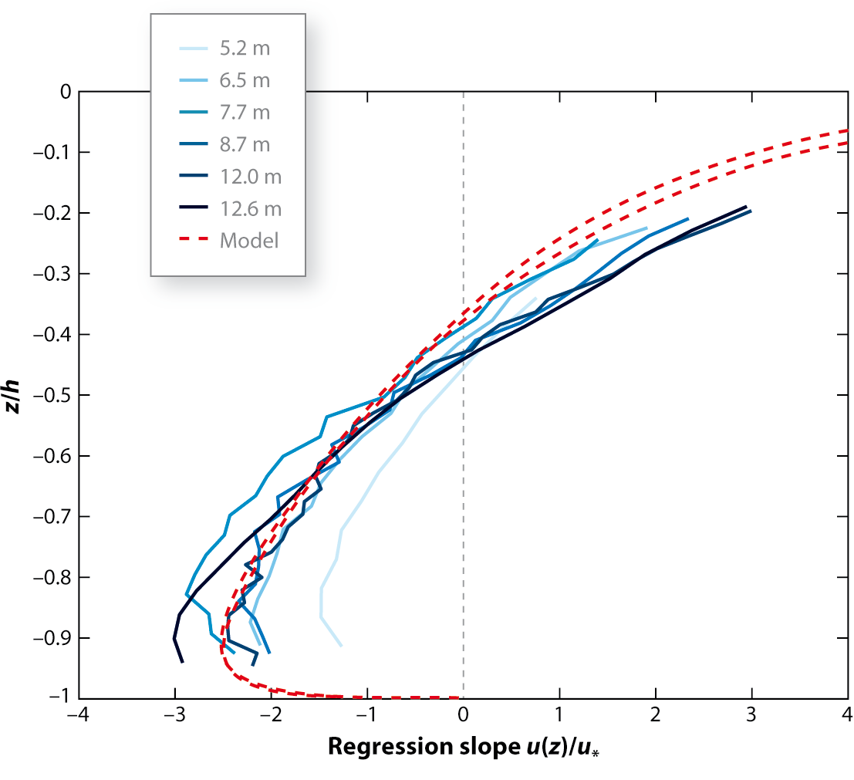
Comparison to observations – current profiles
North Carolina inner shelf

Slide 51
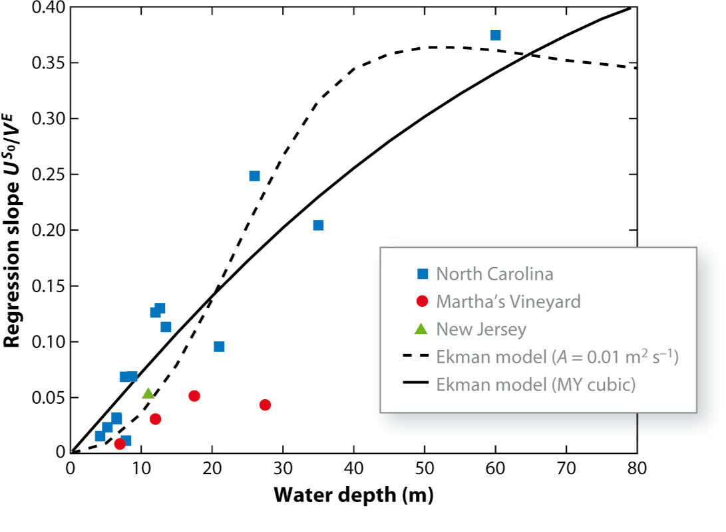
Cross-shelf wind-driven cross-shelf transport linear regression

Slide 52
Summary
Cross-shelf winds drive coastal setup
Effective means of cross-shelf exchange in shallow, unstratified water near the coast

